Slide 1
Determination of
Assigned values and their uncertainties
S. Subramanian

Slide 2
According to the standards and guidelines
mentioned, following possibilities for the assigned value are given in the increasing order of Uncertainty of Assigned Value x_{pt}
• Known values from formulation
• Certified reference Material
• Results from one Lab
• Consensus values from expert laboratories
• Consensus values from participant results
Regardless of method used to derive A.V, check the validity of A.V for each round

Slide 3
Uncertainty of Assigned Value – u(x_{pt})
Competent proficiency test provider should report the uncertainty of the assigned value
Participants need it
  For judgement of their performance
  For estimation of measurement uncertainty from PT data
  PT Provider should have criteria for acceptability of an Assigned Value in terms of its uncertainty – i.e u(x_{pt}) ≤ 0.3 SDPA

Slide 4
Known values from formulation – 7.3
(ISO 13528)
If a sample is prepared synthetically by mixing constituents in specified proportions or by adding a specified quantity of a substance to a base material (e.g) cement content of hardened concrete (cement, aggregate and water are mixed at definite proportion)
The assigned value is derived by calculation from the masses used
Caution: The analyte might be more loosely bound than in typical materials

Slide 5
Known values from formulation – 7.3
CARE TO BE TAKEN WHILE PREPARING PT ITEMS
Base material free from added constituent
Constituents mixed homogeneously
All significant sources of error are identified
No adverse interaction between constituents
Behaviour of PT items prepared is similar to routinely tested samples

Slide 6
Known values from formulation – 7.3
Measurement Uncertainty
Calculation of an uncertainty budget according to GUM including
  all volumetric and gravimetric steps
  other uncertainty contributions, e.g. From
    Purity of substances
    In-homogeneity
    Instability
    Adsorption
    Reaction with constituents in the base material
    Concentration of analyte in the base material
  based on the law of uncertainty propagation

Slide 7
Known values from formulation – 7.3
Advantages/disadvantages
Advantage
  If the analytical method is biased or the participating labs are biased on average it will be a better estimate for the true value
  Uncertainty generally is lowest
  If all uncertainty contributions are covered and the purity of the substances is well defined, the assigned value might be traceable to SI
Disadvantage
  If the analyte is more loosely bound than in typical materials, the difficulty of the analysis might be lower (not representative)
  If there is unrecognized instability, adsorption or reaction with matrix constituents the assigned value will be biased

Slide 8
Certified reference Materials– 7.4
(ISO 13528)
If the PT material is a
Certified Reference Material
the certified value can be used

Slide 9
Certified reference Materials– 7.4
Uncertainty
Usage of the uncertainty from the certificate
Caution: Certificates may report uncertainties on a different confidence level (coverage factor)

Slide 10
Certified reference Materials– 7.4
Advantages/disadvantages
Advantage
  Traceability
  Second lowest uncertainty
Disadvantage
  Might be expensive
  Suitable CRMs might not be available
  A CRM may be known to participant – Important to conceal the identity of PT item
  CRMs are often processed heavily to ensure long term stability which may compromise commutability of samples

Slide 11
Results from one Laboratory – 7.5
Preparation of a reference material-
as per ISO 17034:2016
A number of test portions are randomly selected:
  Analysis in one lab under repeatability conditions together with a certified reference material
  Analysis with a primary method
The assigned value is derived:
  from a calibration against the certified reference value
  from the results of the primary method

Slide 12
Results from one Laboratory – 7.5
The assigned value is derived from formula:
x_{pt} = x_{CRM} + Average “d”
Average “d” = Average of the difference (RM – CRM) for each of the “n” results
(take sign also into consideration)

Slide 13
Results from one Laboratory – 7.5
Measurement Uncertainty
When a suitable CRM is not available for calibrating/characterizing the RM, Reference Value can be obtained from an appropriate source – Ensure metrologocal traceability & Measurement uncertainty needed
If the samples and the CRM are not similar (in matrix, composition and level of results), the additional uncertainty arising from this is also to be included

Slide 14
Results from one Laboratory – 7.5
Measurement Uncertainty
The assigned value is derived from formula:
u(x_{pt}) = SQRT(u²_{CRM} + u²_{d} )
u_{CRM} = Std. uncertainty derived from the certificate of the CRM
u_{d} = Standard Error of the “n” differences
Combination of the uncertainty of the certified reference value with the uncertainty of the measurements

Slide 15
Results from one Laboratory – 7.5
Advantages/disadvantages
Advantage
  Might be traceable to SI through the CRM or the primary method
  Third lowest uncertainty uncertainty
  Not as expensive as direct usage of CRM
Disadvantage
  It is assumed that there are no interactions between materials used and the test conditions
  CRMs that are similar enough to test samples in the required matrix and concentration are often not available
  Primary method is not available
  Results are dependent of one laboratory

Slide 16
Consensus values from expert laboratories
– 7.6
Samples are prepared and distributed to expert laboratories first (Similar to approach of ISO Guide 35 – CRM characterization)
The results of the expert laboratories are used to estimate Robust Mean using Algorithm A
No. of expert labs will normally be small -6 or 8. Hence, use the method with caution

Slide 17
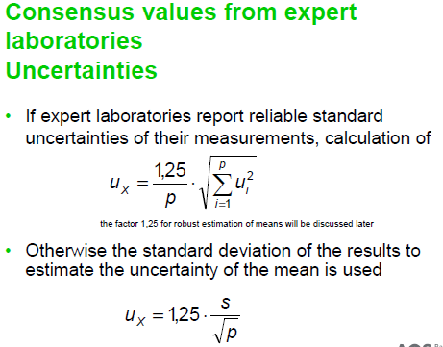

Slide 18
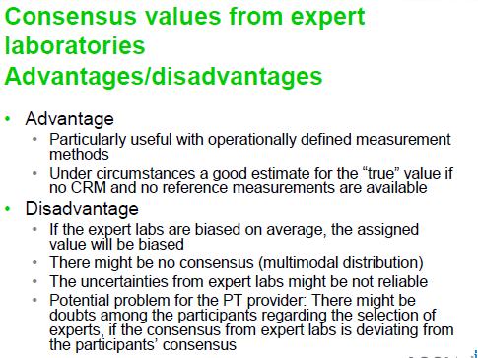

Slide 19
Consensus values from participants
– 7.7
Consensus Values from
(a) All participants or
(b) Expert participants
If expert participants – predefined criteria such as accreditation status or on the basis of previous performance
Algorithm A for determining Assigned Value

Slide 20
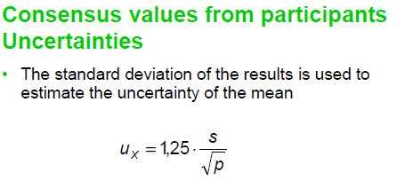
As Assigned Value and Robust SD are determined from participant results, Uncertainty of Assigned Value can be assumed to include the effects of uncertainty due to in-homogeneity, transport & instability

Slide 21
